Slide 1
Environmental Permitting
Brett Nelson
January 29, 2020

Slide 2
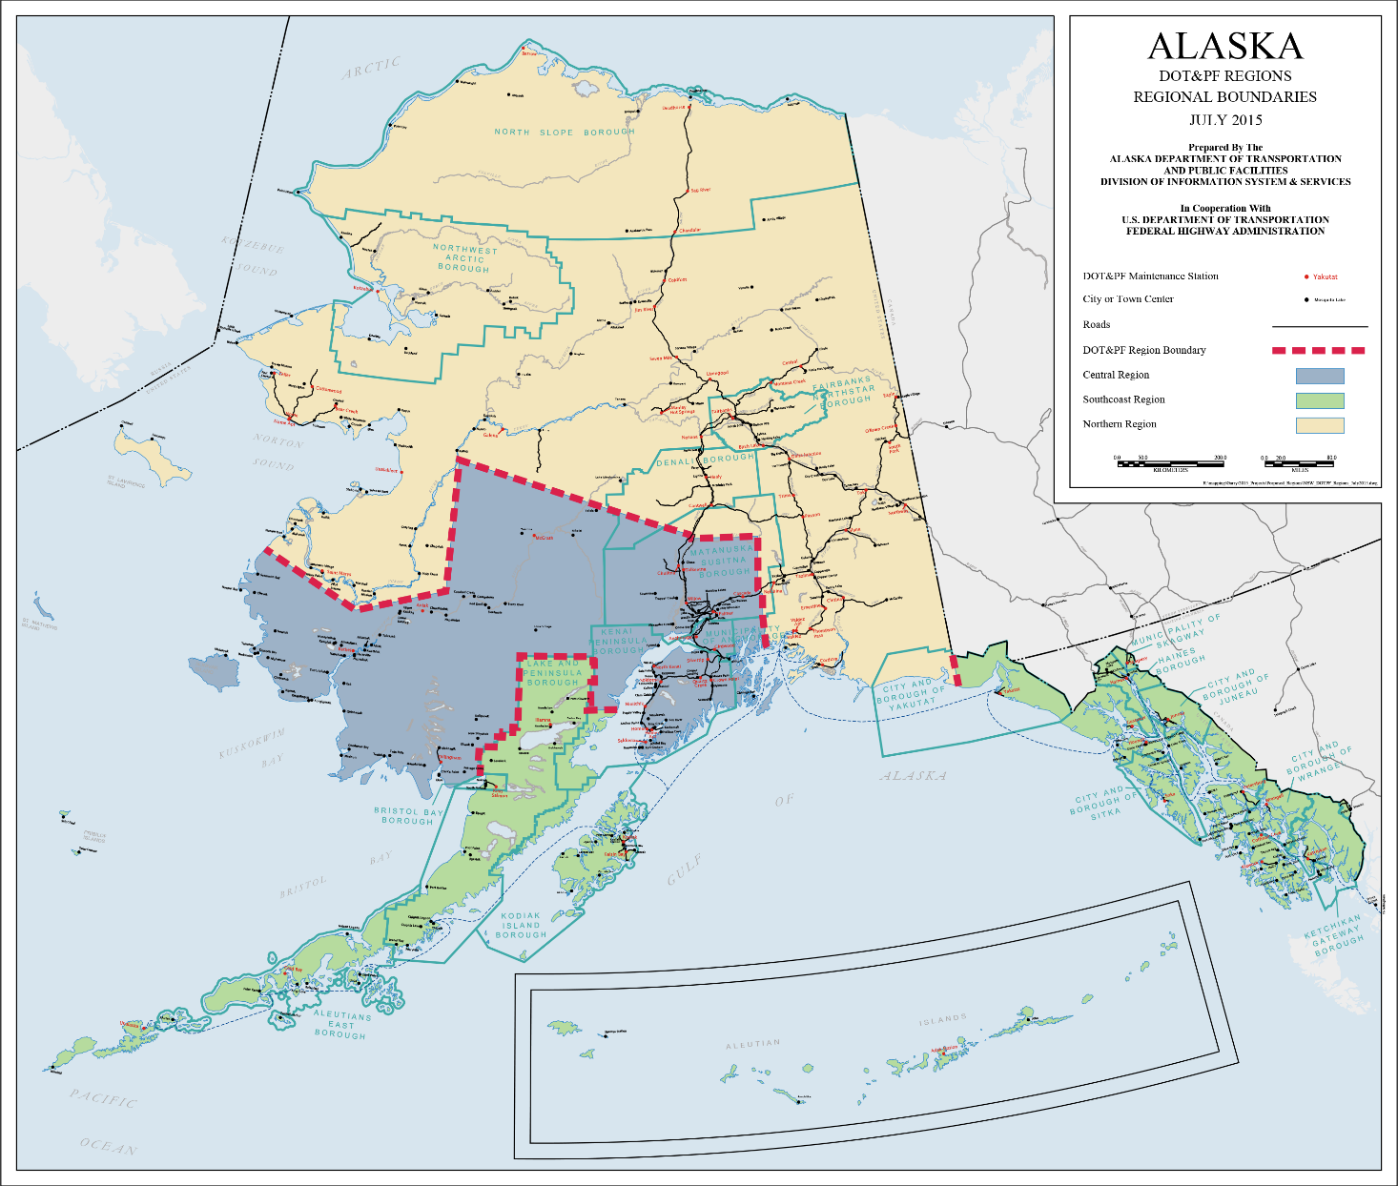
NORTHERN REGION OVERVIEW
Region | Road Lane Miles | Maintenance Stations | Airports
Northern | 8,920 | 37 | 101
Central | 4,632 | 20 | 70
Southcoast | 1,528 | 19 | 69
Northern Region Stats
124 communities
6 boroughs
Over 50 city governments
Over 100 tribes
1 metropolitan planning organization (FAST Planning)

Slide 3
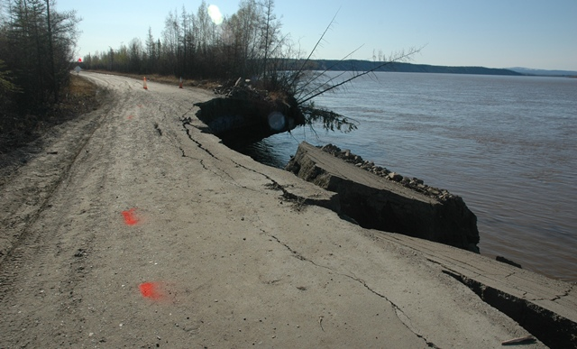
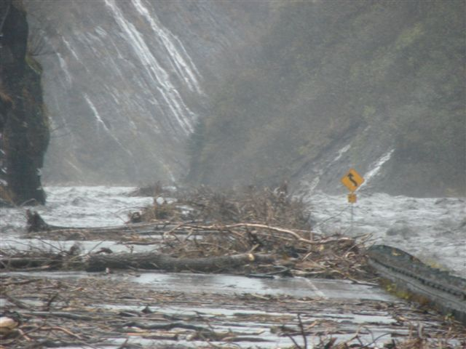
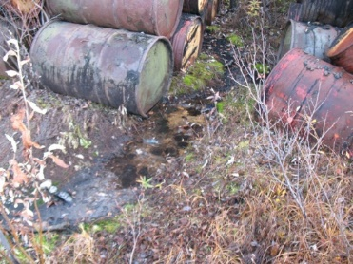
Role of DOT&PF Environmental Staff
Why Environmental Staff in a Transportation Department?
Staff assist with M&O, Planning, Design, and Construction
Knowledge of environmental laws, regulations, processes
Understanding of DOT&PF projects and activities
Liaison between DOT&PF and regulatory agencies
1/29/2020

Slide 4
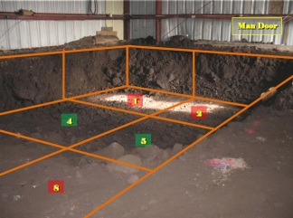
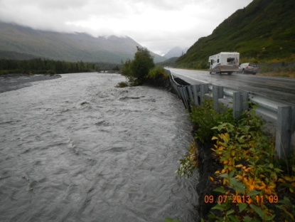
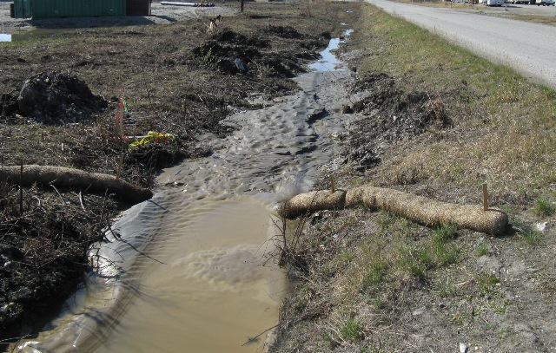
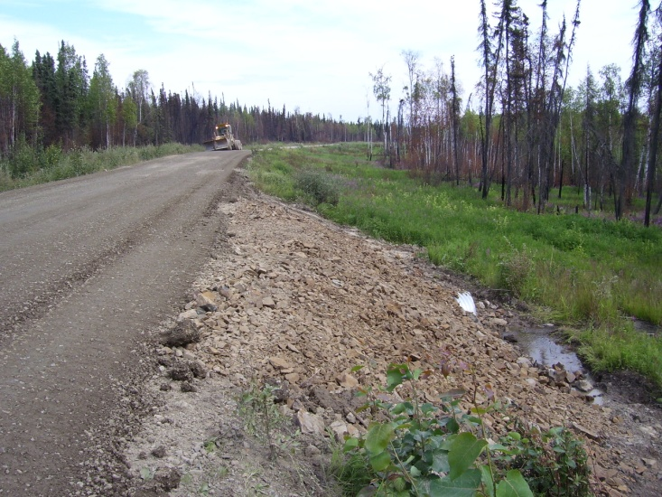
DOT&PF Environmental Staff
Where Are Environmental Staff at DOT&PF?
Staff cover a broad range of topics across the State
Regional Staff (Northern, Central, Southcoast)
Design & Construction / Cultural Resources
M&O / Spills & HazMat
Stormwater
Statewide Environmental Office (SEO)
NEPA / Cultural Resources / Compliance – Stormwater
Airports (AIA, FAI)
1/29/2020

Slide 5
Environmental Needs at DOT&PF
What level of NEPA and types of permits needed?
1/29/2020

Slide 6
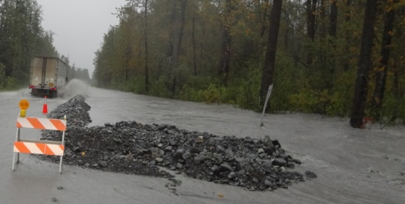
Project Development
How Do We Determine Environmental Requirements?
Funding source of project determines the processes required
FHWA – State took on NEPA Assignment (327 Program)
Beginning Nov. 3, 2017
State acts as lead federal agency on these projects
FAA – State is project sponsor
State – Not an official State “NEPA-type” process
FEMA – Emergency repair projects
Other – includes FHWA-WFL, NOAA, VA, etc.
1/29/2020

Slide 7
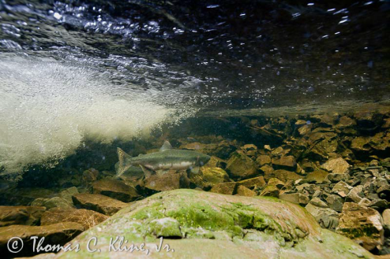
Project Development
How Do We Determine Environmental Requirements?
Potential impacts of project determine how process is worked
Land Ownership
ROW, federal, state, private
Land acquisition, temporary access, lease or use, etc.
Water Resource Impacts
Wetlands, streams and WOTUS, water quality, etc.
Cultural / Historic Properties
Fish & Wildlife
Public (Agency) Involvement
1/29/2020

Slide 8
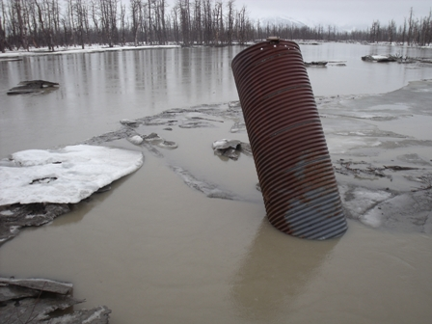
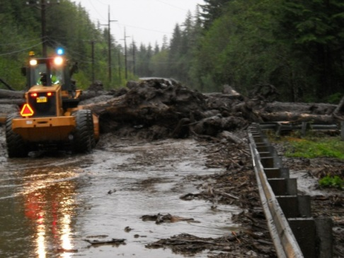
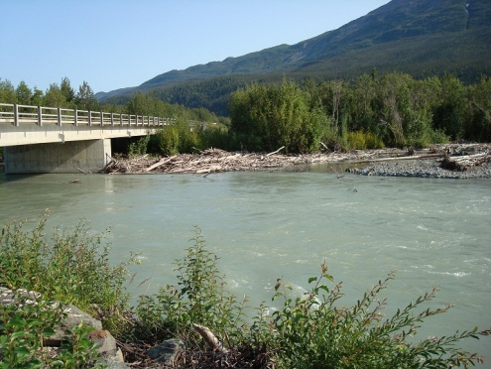
NEPA Process
What Are Some of the Steps in doing FHWA/FAA Project?
Most projects are FHWA, then FAA / primarily CE docs, some EAs
Planning
Planning – Environmental Linkage (PEL)
Design & Environmental
Class of Action, Env Doc, Re-evaluations
Permits
Construction
Maintenance & Operations
1/29/2020

Slide 9
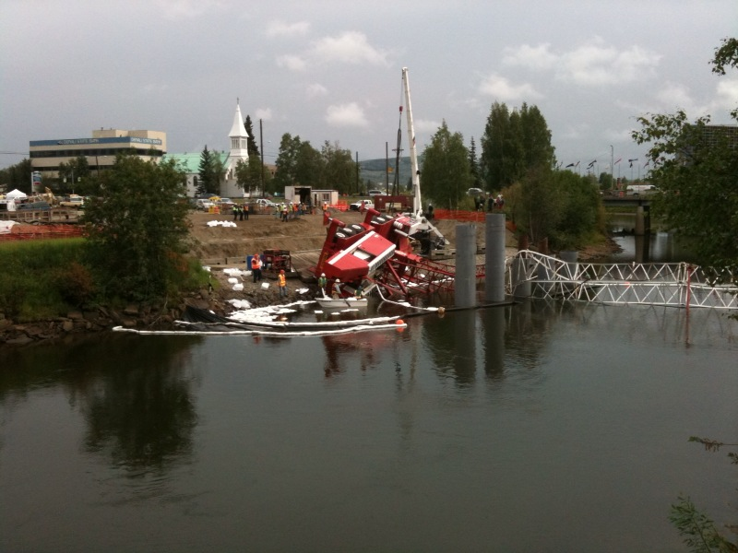
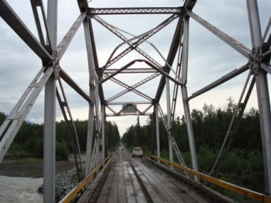
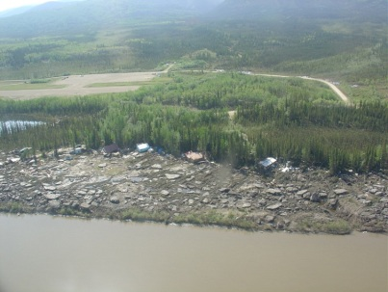
NEPA Document Components
What Are Some Parts of NEPA Documentation?
Documentation varies depending on project scope and impacts
Agency Scoping
Public Involvement
Right-of-Way (ROW) and Social Impacts
Cultural / Historic Properties
Section 106 / Programmatic Agreement
1/29/2020

Slide 10
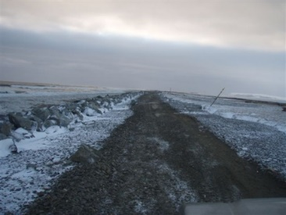
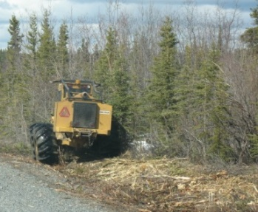
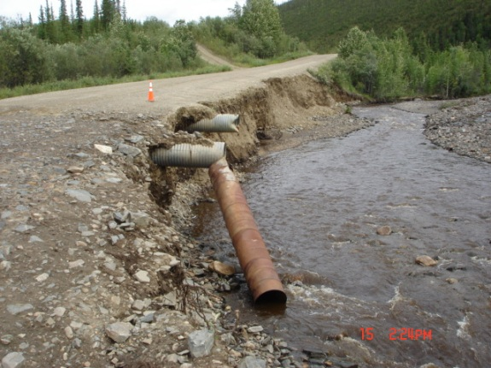
NEPA Document Components
What Are Some Parts of NEPA Documentation?
Wetlands & Waters
Wild & Scenic Rivers – Section 7 Consultation
Impaired Waterbodies – Section 303 CWA
Fish & Wildlife
Essential Fish Habitat (EFH)
Endangered Species Act (ESA)
Migratory Bird Treaty Act (MBTA)
Bald and Golden Eagle Protection Act
1/29/2020

Slide 11
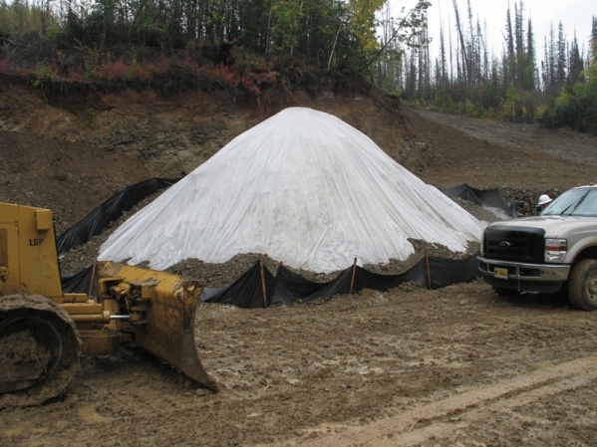
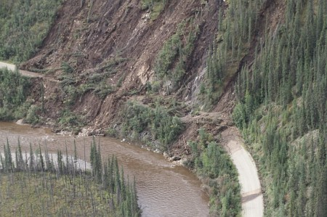
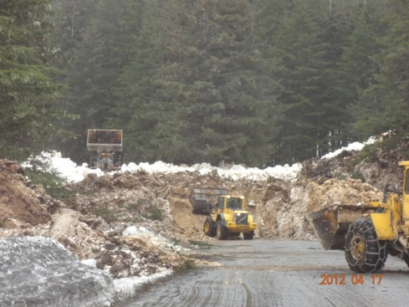
NEPA Document Components
What Are Some Parts of NEPA Documentation?
Invasive Species
Contaminated Sites
Air Quality
PM 2.5 & CO
Floodplains
Noise Impacts
Section 4(f) / Section 6(f)
Environmental Commitments / Mitigation
1/29/2020

Slide 12
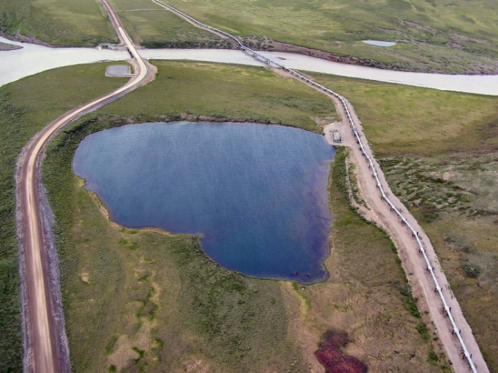
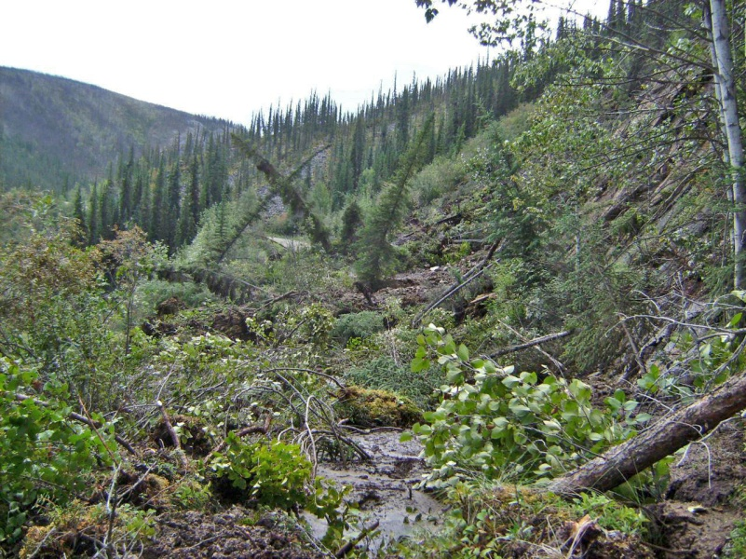
Permits
When Does Most Permitting Take Place?
Permitting typically follows NEPA / in final design, types of permits vary depending on project scope / location
Corps Wetland Permits – Section 404/10 of CWA
NWP
IP
Mitigation
ADF&G Fish Habitat Permit
U.S. Coast Guard Bridge Permit
1/29/2020

Slide 13
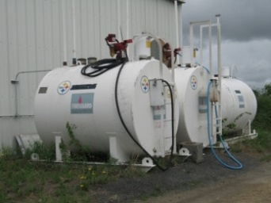
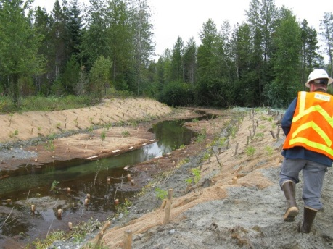
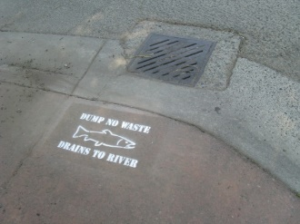
Permits
When Does Most Permitting Take Place?
DEC AK Pollutant Discharge Elimination System (APDES)
Construction General Permit (CGP)
Multi-Sector General Permit (MSGP) – Industrial
Municipal Separate Storm Sewer System (MS4) – Urban
DEC Excavation De-watering Permit
DEC Non-Domestic Wastewater Plan Approval
1/29/2020

Slide 14
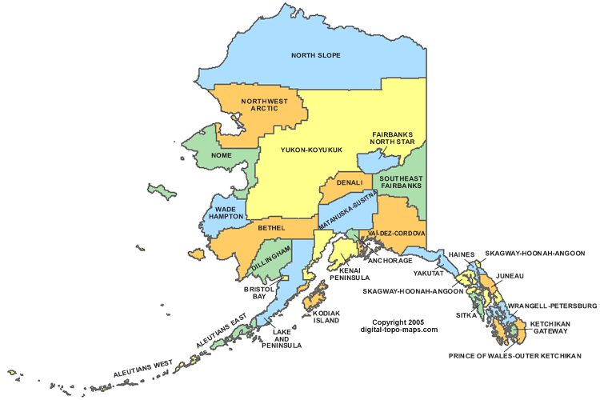
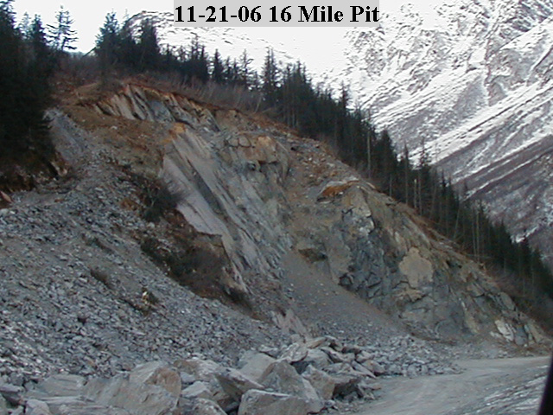
Permits
When Does Most Permitting Take Place?
DNR Temporary Water Use Authorization (TWUP)
Material Site Agreements
DNR
BLM
Local Floodplain Permit
Borough & Local Development Permits
Local Noise Ordinances
1/29/2020

Slide 15
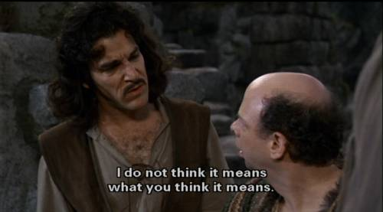
Permits
How Do We Ensure NEPA and Permit Compliance?
This site is permitted, right?
1/29/2020

Slide 16
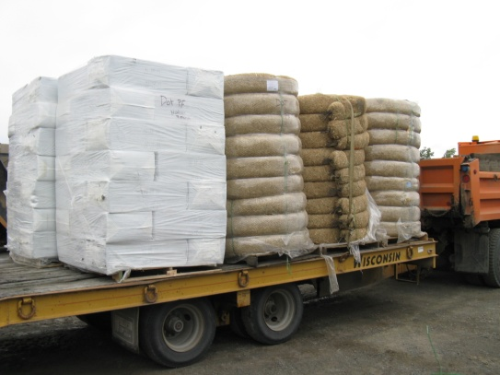
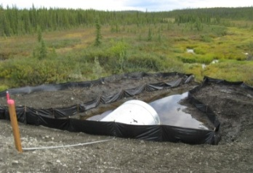
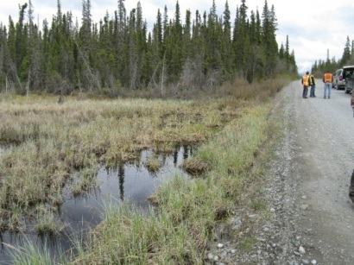
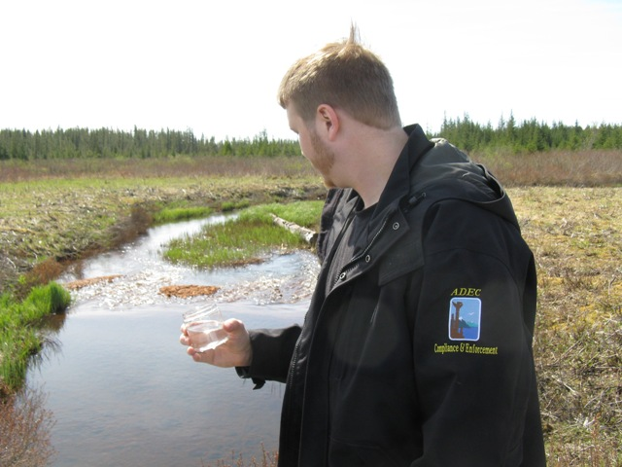
Permit Compliance
How Do We Ensure NEPA and Permit Compliance?
Training, and having staff in the field during construction.
BMPs
Grass seed, Straw wattles, Silt curtain
Good Housekeeping
Spill Kits
Absorbent pads, Floating boom
Photo Documentation
On-line Training
http://dot.alaska.gov/stwddes/desenviron/resources/training.shtml
1/29/2020

Slide 17
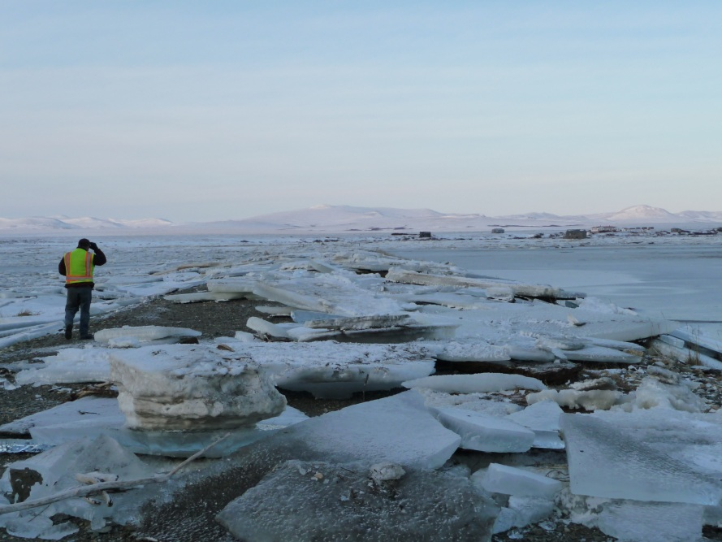
Questions?
Brett Nelson
Northern Region Environmental Manager
Alaska DOT&PF
2301 Peger Road / Fairbanks, AK 99709
(907) 455-2238
1/29/2020

